Slide 1
Public Health Decision Making in a Radiation Emergency
Intermediate Phase Response: 72 hours to 1 month
Notes:
This module will provide an overview of the intermediate response phase activities. The time estimated for this module is 4.5 hours.

Slide 2
Module Overview: T+72hrs -> T+1mo
T+72hrs → T+1wk
Response Activities
Specialized Medical Care
T+1wk → T+1mo
Response Activities
Dose Assessment
Dose Reconstruction
Re-entry
2
Notes:
This module will focus on response activities that will be initiated in the first days and weeks. We will periodically review modeling products for current and future time periods to help shape our understanding of the operational environment and drive decision making.
ASSUMPTIONS INCLUDE:
Early phase response activities are underway, adequately staffed/resourced, and gaining in efficiency/impact.
Field monitoring is underway and the data from environmental monitoring is being used to refine the IMAAC models.
Additional assets have arrived to provide technical assistance and additional manpower.
Planning for upcoming operations will begin prior to the target operational period. For example, planning for a response activity that is targeted for T+72hrs will be initiated no later than T+48hrs.
Planners will use current and projected IMAAC data products to drive response planning.
IMAAC data products will be updated as additional radiation measurements are taken at key locations.

Slide 3
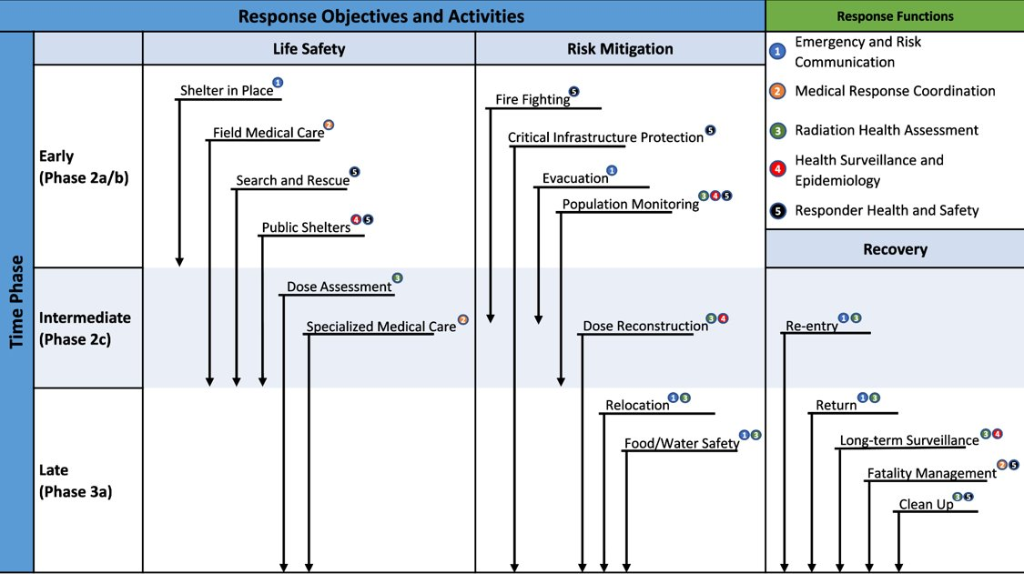
Response Objectives, Functions, and Activities
Notes:
Description of image: Response objectives and activities are organized roughly by time phase (early, intermediate, and late) and by objective (life safety, risk mitigation, and recovery). This set of modules covers the intermediate phase activities.

Slide 4
Dose Assessment
Phase: Early / Intermediate
Objective: Life Safety
Functional Area: Radiation Health Assessment
Notes:
This section explores DOSE ASSESSMENT as an INTERMEDIATE phase response activity. It falls under the LIFE SAFETY response objective. The public health functional area is RADIATION HEALTH ASSESSMENT.
NOTE:
Early dose assessments will primarily be based on how much time a person spends or has spent in certain areas. The information will be used to help determine if the person:
Needs immediate care for a suspected radiation injury
Requires further evaluation and/or specialized medical care
In the case of responders – emergency workers responding to this emergency early on may exceed the occupational dose limits
EPA PAGs have higher dose guidelines for life saving and protecting critical infrastructure. NCRP Report 165 and 179 and I believe NCRP Commentary 19 discuss dose guidelines in the 50 rem range.

Slide 5
Response Objectives, Functions, and Activities Dose Assessment
Notes:
Description of image: Response objectives and activities are organized roughly by time phase (early, intermediate, and late) and by objective (life safety, risk mitigation, and recovery). Dose assessment falls among intermediate phase life safety activities.

Slide 6
Dose Assessment Learning Objectives
Identify methods used to estimate dose received by:
Responders
Members of the public
Describe what dose levels need further evaluation and treatment.
Notes:
The learning objectives for this section are to identify factors that should be considered for:
Identify methods used to estimate dose received by members of the public.
Identify methods used to estimate dose received by responders.
Describe what dose levels need further evaluation and treatment

Slide 7
Dose Assessment Relationships
Prerequisites
Shelter-in-place
Initial Interagency Modeling and Atmospheric Assessment Center (IMAAC) modeling
Concurrencies
Evacuation
Population monitoring
Public shelters
Dependencies
Relocation
Dose reconstruction
Re-entry
Return

Slide 8
Background: Dose Assessment
Dose assessment is performed to assess the radiological impact of a release of radioactive materials throughout all phases of a radiation emergency.
Location of the radiologically affected area
Amount and type of radioactive materials
Radiation doses to be received by responders and the public
Dose assessment results are used for two main purposes:
Determine appropriate protective actions for responders and the public.
Identify appropriate medical treatment for exposed and contaminated individuals.
Especially in high-exposure scenarios, treatment success depends on accurate estimates of dose received.
Notes:
In the event of a terrorist-driven radiological event, emergency radiation dose assessment by first responders will be necessary to identify and focus the use of precious medical resources.
Incidents may result in external exposure (radiation dose, without the presence of radioisotope(s) in or on the body) and/or the uptake of radioactive materials by inhalation, ingestion, skin absorption, wound contamination or injection of radioisotope(s) as embedded material.
Radiation dose assessment is critically important because medical treatment depends on understanding the dose an individual receives. Treatment guidance will depend on the therapy type employed.

Slide 9
Radiation Exposures
In the event of a terrorist-driven radiological event, emergency radiation dose assessment by first responders will be necessary to identify and focus the use of precious medical resources.
Types of exposure
External (radiation dose)
Internal (uptake of radioactive materials into the body) by
Inhalation
Ingestion
Skin absorption
Wound contamination/injection

Slide 10
Dose Assessment Methods
Phase | Methods
Early | Initial IMAAC models Time/location estimates Dosimetry (when available) Individual dosimetry Representative dosimetry
Intermediate | Refined models Dosimetry data Field measurements
Late | All of the above, plus Bioassay (e.g., urine analysis) Biodosimetry (e.g., dicentric chromosome assay) Whole body counting Blood samples [total complete blood count (CBC) with differentials]
Notes:
Description of image: Dose assessment methods vary by time phase. Earlier on, assessment depends on modeling and estimates; as time advances, dosimetry, field data, and sample analysis give a more complete picture.

Slide 11
Individual Dose Assessment Techniques
Bioassay: a measurement of radioactive materials present inside a person’s body through analysis of the person’s blood, urine, feces, or sweat.
Bioassay determines past, current and future radiation dose from a contamination incident.
Biodosimetry: The use of physiological, chemical or biological markers of exposure of human tissues to ionizing radiation for the purpose of reconstructing doses to individuals or populations.
Biodosimetry determines a past radiation dose from an exposure incident.
Notes:
https://remm.hhs.gov/explainbiodosimetry.htm

Slide 12
Dose Assessment Partners
In addition to radiation control, these partners may have a role:
Public health
Radiation Emergency Assistance Center/Training Site (REAC/TS)
Hospitals
Laboratories
Meteorologists
12
Notes:
PROMPT AUDIENCE: Share information for the first bullet, if they haven’t already done so.

Slide 13
Where does dose assessment occur?
State and federal radiation control program offices
National laboratories
Using data collected at community reception centers (CRCs) and other locations
Notes:
***ADD NOTES***

Slide 14
What dose levels require further evaluation and treatment?
Early dose assessment will largely be driven by symptom and location at the time of the incident.
Patients showing signs of Acute Radiation Syndrome (ARS) will be triaged for specialized medical care based on estimated radiation dose.
Below 2 Gy (200 rad) – no urgent action, routine follow-up
2-6 Gy (200-600 rad) – priority for cytokine administration
Above 6 Gy (600 rad) – observation/comfort care; cytokines may be provided depending on available resources and prognosis.
Notes:
Early dose assessment will be largely driven by symptom and location at the time of event.
“[PAGs] are not meant to be applied as strict numeric criteria, but rather as guidelines to be considered in the context of incident-specific factors . . . the guidelines should not be viewed as inflexible limits . . . incident commanders are responsible for balancing the individual risks and public benefits of each worker action.”
Dose assessment will help guide medical care.
Patients demonstrating signs of ARS will be triaged for specialized medical care based on radiation dose.
Estimated dose below 200 rem (2 Gy) - no urgent action, routine follow-up
Estimated dose between 200-600 rem (2-6 Gy) - priority for cytokine administration and specialized medical care
Estimated dose above 600 rem (6 Gy) - observation/palliative care

Slide 15
What decisions are driven by dose assessment?
Early phase
Public: Evacuate, shelter-in-place
Responders: personal protective equipment (PPE), dosimetry, limited stay times in affected areas
Location of field activities (medical care, population monitoring, public shelters) and need for countermeasures
Intermediate phase
Public: Relocation, restrictions on food/water
Continued responder protection
Establish priorities for field monitoring
Public: Relocation, restrictions on food/water
Notes:
Dose assessment is done to determine
What it is
Where it is
How much there is
What risks does it pose
What do we need to have to deal with it

Slide 16
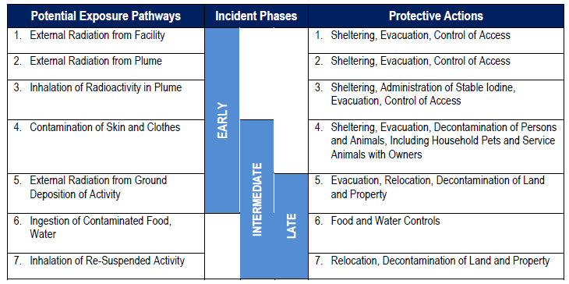
Potential Exposure Pathways and Corresponding Protective Actions Chart
https://remm.hhs.gov/NRIA_FINAL_110216.pdf
Notes:
Description of Image: This chart correlates radiation exposure pathways and incident phases with the appropriate protective actions. The time scale advances from top to bottom.
NUCLEAR/RADIOLOGICAL INCIDENT ANNEX (hhs.gov)
This is taken from p. 46 of the 2016 edition of the Nuclear/Radiological Incident Annex.

Slide 17
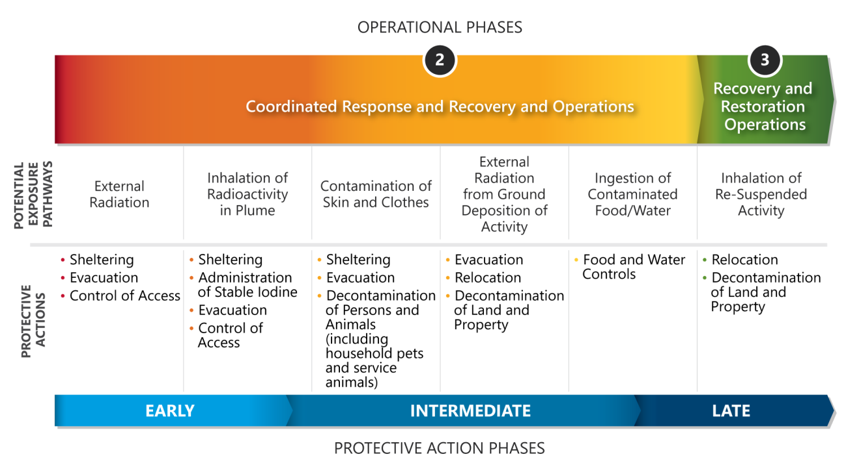
Potential Exposure Pathways and Corresponding Protective Actions Chart with Operational Phases
https://www.fema.gov/sites/default/files/documents/fema_incident-annex_nuclear-radiological.pdf
Notes:
Description of image: A figure demonstrating potential exposure pathways, their corresponding protective actions, and approximate operational phase. The time scale advances from left to right.
This diagram extends the one in the previous slide by including the FEMA operational phases (shown in color at the top fading from red to green), as well as the protective action phases (shown in blue at the bottom, going from lighter to darker).

Slide 18
Dose Assessment Resources

Slide 19

Prioritization of Laboratory Samples Following a Radiological Event: Considerations
This document provides an overview of some considerations that decisionmakers might include in the prioritization process.
It is not a guidance document, as each incident will present its own challenges.
A task force created by the National Alliance for Radiation Readiness developed these considerations.
https://www.radiationready.org/posted-tools/prioritization-of-laboratory-samples-following-a-radiological-event-considerations/
Notes:
Description of Image: Logo for National Alliance for Radiation Readiness
Prioritization of Laboratory Samples Following a Radiological Event: Considerations - National Alliance for Radiation Readiness (radiationready.org)

Slide 20
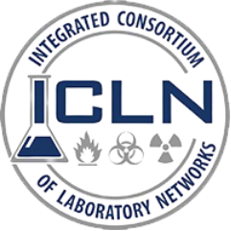
Sample Prioritization for Incident Decision Making
This guidance by the Integrated Consortium of Laboratory Network (ICLN) promotes the efficient use of laboratory resources through sample prioritization.
The document highlights the types of decisions these groups need to make to best prioritize the samples being submitted to the various laboratories.
See Appendix D: Radiological Scenario Descriptions and Corresponding Phase Diagrams.
https://www.icln.org/resources/subgroups/sample-prioritization/index.cfm
Notes:
Description of Image: Integrated Consortium of Laboratory Network (ICLN) Logo
https://www.icln.org/resources/subgroups/sample-prioritization/index.cfm
See Appendix D: Radiological Scenario Descriptions and Corresponding Phase Diagrams

Slide 21
Dose Assessment References

Slide 22
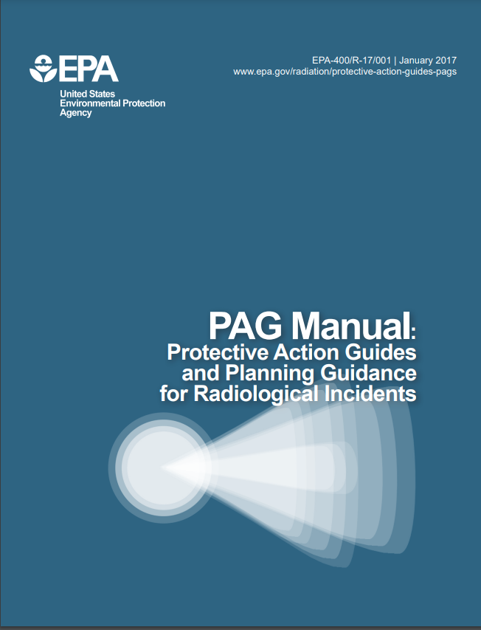
PAG Manual: Protective Action Guides and Planning Guidance for Radiological Incidents
The U.S. Environmental Protection Agency (EPA) has developed this Manual to assist public officials in planning for emergency response to radiological incidents.
This Manual provides radiological protection criteria for application to all incidents that would require consideration of protective actions.
https://www.epa.gov/sites/default/files/2017-01/documents/epa_pag_manual_final_revisions_01-11-2017_cover_disclaimer_8.pdf
Notes:
Description of Image: Cover of the PAG Manual: Protective Action Guides and Planning Guidance for Radiological Incidents.
https://www.epa.gov/sites/default/files/2017-01/documents/epa_pag_manual_final_revisions_01-11-2017_cover_disclaimer_8.pdf
Chapters 2 & 3

Slide 23
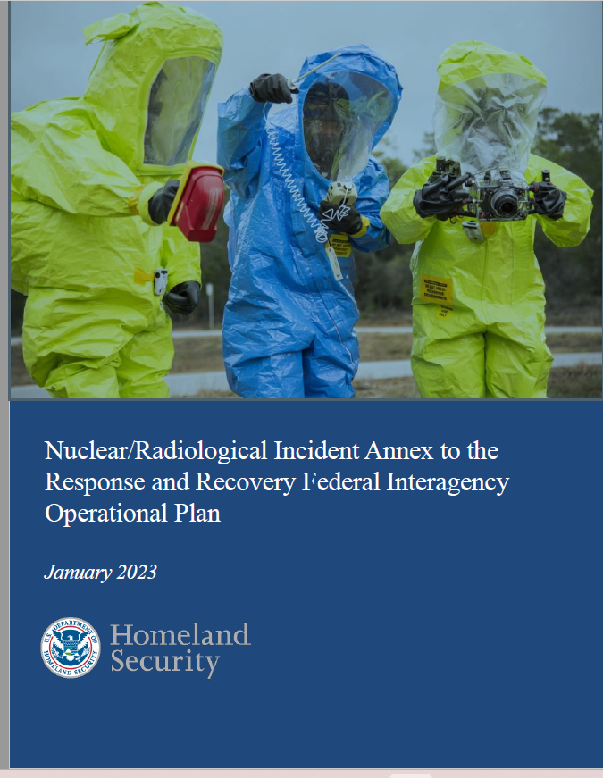
Nuclear/Radiological Incident Annex to Response and Recovery Federal Interagency Operational Plan
The Federal Interagency Operational Plan (FIOP) provides a coordination and communication framework for interagency activities in response to and recovery from all hazards.
The NRIA complements the FIOP by utilizing the same base concept of operations but also provides federal guidance specific to the unique considerations of nuclear/radiological incidents.
Photo credit: FEMA NRIA
https://www.fema.gov/sites/default/files/documents/fema_incident-annex_nuclear-radiological.pdf
Notes:
Description of image: Cover of Nuclear/Radiological Incident Annex to the Response and Recovery Federal Interagency Operational Plan
https://www.fema.gov/sites/default/files/documents/fema_incident-annex_nuclear-radiological.pdf

Slide 24
The Medical Aspects of Radiation Incidents, 4th Edition
Medical care providers are expected to deliver care to patients because of a multitude of scenarios.
One of those scenarios involves the patient who has been exposed to and/or contaminated with radioactive materials.
This document is intended to provide basic information to physicians and other healthcare professionals necessary for the proper medical management of these individuals.
https://orise.orau.gov/resources/reacts/documents/medical-aspects-of-radiation-incidents.pdf
Notes:
Description of Image: Cover of The Medical Aspects of Radiation Incidents, 4th Edition document.
https://orise.orau.gov/resources/reacts/documents/medical-aspects-of-radiation-incidents.pdf

Slide 25
Questions regarding Dose Assessment?

Slide 26
Dose Reconstruction
Phase: Intermediate / Late
Objective: Risk Mitigation
Functional Area: Radiation Health Assessment / Health Surveillance
Notes:
This section explores DOSE RECONSTRUCTION as an INTERMEDIATE / LATE phase response activity. It falls under the RISK MITIGATION response objective. The public health functional areas are RADIATION HEALTH ASSESSMENT / HEALTH SURVEILLANCE.
NOTE:
Dose reconstruction is retrospective in nature. Dose reconstruction efforts initiated in the intermediate phase will continue into the late phase and will involve the collection of data in a variety of forms, including:
Individual interviews
Reported/observed health effects
Clinical tests
Individual and group dosimetry reports (for responders, if applicable)
Environmental monitoring data
For comparison, dose assessment is prospective in nature – radiation exposures are estimated using the current/best available information:
Establish responder health and safety protocols
Support protective actions for the public
Triage potential radiation casualties based on dose

Slide 27
Response Objectives, Functions, and Activities Dose Reconstruction
Notes:
Description of image: Response objectives and activities are organized roughly by time phase (early, intermediate, and late) and by objective (life safety, risk mitigation, and recovery). Dose reconstruction falls among the intermediate phase risk mitigation activities.

Slide 28
Dose Reconstruction Learning Objectives
Describe which agencies are involved in dose reconstruction for responders and members of the public.
Identify methods to determine doses received by responders and members of the public.
Notes:
The learning objectives for this section are to:
Describe which agencies are involved in dose reconstruction for responders and members of the public.
Identify methods to determine doses received by responders and members of the public.

Slide 29
Dose Reconstruction Relationships
Prerequisites
Dose Assessment
Dosimetry information from responders
Screening information from evacuees
Location/duration information from members of public
Post-incident models
Follow-on testing and tracking of affected individuals

Slide 30
Dose Reconstruction Relationships, cont'd.
Concurrencies
Return
Cleanup
Dependencies
Long-term Health Surveillance

Slide 31
Background: Dose Reconstruction
Dose reconstruction is the retrospective dose assessment based on representative individuals/populations.
Considers all possible sources and pathways of radiation exposure.
Generally focuses on identifying individuals at greater risk for developing cancer.
Accurate dose reconstruction will depend on information gathered throughout the incident response.
More accurate information early on will significantly assist in the process later.

Slide 32
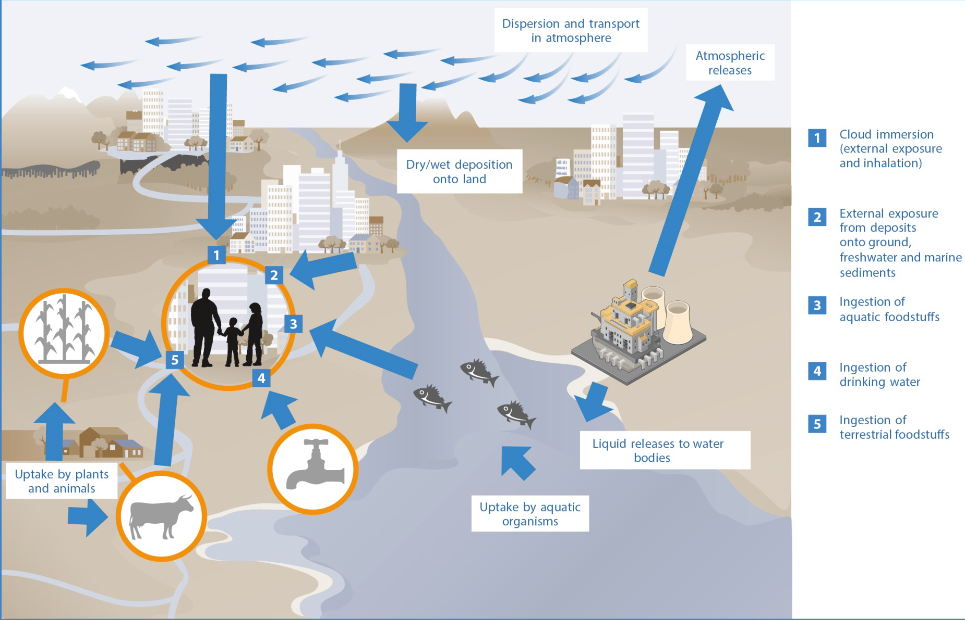
Multiple Pathways to Internalize Radioactive Materials in the Environment
There are multiple pathways through which people can internalize radioactive materials in the environment.
32
https://www.unscear.org/unscear/uploads/documents/publications/UNSCEAR_2016_Annex-A-CORR.pdf
Notes:
Description of Image: Illustration of exposure pathways in the environment through which people may be exposed to radiation, including air, water, food, and material deposited on the ground.
When radionuclides are discharged to the environment there are various ways in which people can be exposed to radiation. This image illustrates the important exposure pathways: 1) cloud immersion (external exposure and inhalation) 2) eternal exposure from deposits onto the ground freshwater and marine sediments 3) ingestion of aquatic foodstuffs 4) ingestion of drinking water 5) ingestion of terrestrial foodstuffs.
https://www.unscear.org/unscear/uploads/documents/publications/UNSCEAR_2016_Annex-A-CORR.pdf

Slide 33
Dose Assessment vs. Dose Reconstruction
Both derive dose estimates from modeling and measurements
Dose assessment estimates recent or near-future dose
Useful for protective action decision making
Useful for medical management
Dose reconstruction estimates population and individual doses
Useful for long-term follow up and health monitoring studies
Both use information collected in the early phase

Slide 34
Dose Reconstruction Partners
In addition to public health, these partners may have a role:
Radiation control
Hospitals
Laboratories
Meteorologists
Department of Energy (DOE)/Health and Human Services (HHS)/Environmental Protection Agency (EPA)
Federal Radiological Monitoring and Assessment Center (FRMAC)
Advisory Team (A-Team)
National Institute for Occupational Safety and Health (NIOSH)
Notes:
PROMPT AUDIENCE: Share information for the first bullet, if they haven’t already done so.

Slide 35
Where/how does dose reconstruction occur?
Community Reception Centers (CRCs)
Initial collection of basic information occurs at CRCs
State and federal public health offices
Public health will conduct epidemiological investigations to:
Identify late-onset health effects
Correlate radiation dose and health outcomes
This information will be organized in a radiation exposure registry to facilitate long-term follow up.
Notes:
The information collected at CRCs will serve as the baseline for creating registries for long-term follow-up.
This information should include (at a minimum):
Name
Contact Information
Location at time of incident/duration in affected area
Contamination status at CRC
Presence of ARS signs/symptoms
State and federal officials will create and maintain exposure registries to fully assess the public health impact of the incident. Epidemiologists and public health staff will conduct follow-up interviews to identify late-onset health effects.

Slide 36
Which agencies are involved in dose reconstruction for responders and members of the public?
State radiation control and public health agencies
Federal assistance
Department of Energy (DOE)
Health and Human Services (HHS)
Environmental Protection Agency (EPA)
Additional occupational radiation safety expertise
Occupational and Safety Health Administration (OSHA)
National Institute for Occupational Safety and Health (NIOSH)
Radiation Emergency Assistance Centers/Training Site (REAC/TS)
National labs
Nuclear Regulatory Commission (NRC)
Notes:
State radiation control and public health agencies will lead the preliminary effort. Additional federal assistance will come from DOE, HHS, and EPA.
NIOSH has particular expertise in dose reconstruction as part of the DCAS program (the program that assesses doses to former radiation workers for compensation). [Division of Compensation Analysis and Support]
Additional occupational radiation safety expertise may be available through OSHA, NIOSH, NRC, national labs, DOE and REAC/TS.
The combined efforts of these agencies will define the parameters for dose reconstruction and establish a functioning exposure registry.

Slide 37
Which methods can be used to determine doses received by responders and members of the public?
Public health will need to work with agency partners to ensure dose reconstruction efforts capture all possible sources of information.
Data collected during the response will provide the basis for dose reconstruction, including:
Environmental measurements
Individual contamination screening data captured at CRCs
Dosimetry data collected from responders
Internal dosimetry data collected from people who require follow-up care or assessment for radiation injury
Statistical modeling may also be used to extrapolate dose estimates to broader populations
Notes:
Public health will need to work with agency partners to ensure dose reconstruction efforts capture all possible sources of information. Data collected during the response will provide the basis for dose reconstruction, including:
Environmental measurements
Individual contamination screening data captured at Community Reception Centers (CRCs)
Dosimetry data collected from responders
Internal dosimetry data collected from people who require follow-up care or assessment for radiation injury
Statistical modeling may also be used to extrapolate dose estimates to broader populations

Slide 38
What health risks are associated with low-level radiation exposure?
Cancer is the most well-established and most studied adverse health effect following exposure to radiation.
Associations of other adverse health outcomes including:
cardiovascular disease
neurological disorders
immune dysfunction
cataracts and other lens opacities
The public may be concerned about heritable genetic effects following low-dose radiation exposures; however, to date no evidence has been found.
Notes:
Although early experimental findings in fruit flies (Muller, 1927) and mice (Russell, 1951) have indicated that ionizing radiation causes heritable genetic effects, human data have not replicated the early experimental findings and often have had limited statistical power owing to small sample size, low gonadal dose, lack of dosimetry information, or inadequate comparison groups (Boice and Miller, 1999; Lim et al., 2015; Signorello et al., 2010).
Source:
National Academies of Sciences, Engineering, and Medicine; Division on Earth and Life Studies; Nuclear and Radiation Studies Board; Committee on Developing a Long-Term Strategy for Low-Dose Radiation Research in the United States. Leveraging Advances in Modern Science to Revitalize Low-Dose Radiation Research in the United States. Washington (DC): National Academies Press (US); 2022 Oct 20. 2, Low-Dose Radiation Exposures and Health Effects. Available from: https://www.ncbi.nlm.nih.gov/books/NBK586463/

Slide 39
Dose Reconstruction References

Slide 40
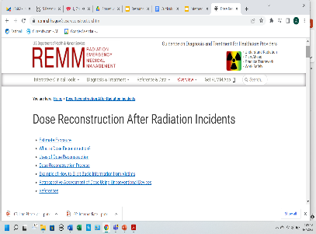
Dose Reconstruction After Radiation Incidents
Initial estimates often are required on short notice because the incident is unplanned, occurs without warning, and may require immediate triage and treatment of many victims.
This type of dose reconstruction is the primary focus of Radiation Emergency Medical Management (REMM).
https://remm.hhs.gov/dosereconstruction.htm
Notes:
Description of Image: REMM Webpage for Dose Reconstruction After Radiation Incidents
https://remm.hhs.gov/dosereconstruction.htm

Slide 41
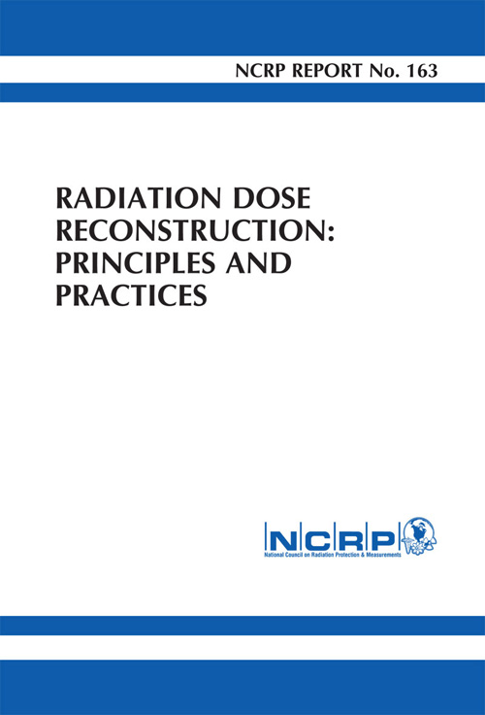
NCRP Report, No. 163, Radiation Dose Reconstruction: Principles and Practices
Radiation dose reconstruction is the retrospective assessment of dose to identifiable or representative individuals or populations by any means.
The scope of dose reconstruction includes estimates of absorbed dose to individual organs or tissues for specified exposure situations in support of epidemiological studies or compensation programs, to guide interventions in accidental or malevolent exposures, or for individual or public information.
https://ncrponline.org/shop/reports/report-no-163-radiation-dose-reconstruction-principles-and-practices/
Notes:
Description of Image: Cover of Radiation Dose Reconstruction: Principles and Practices NCRP Report No. 163
https://ncrponline.org/shop/reports/report-no-163-radiation-dose-reconstruction-principles-and-practices/

Slide 42
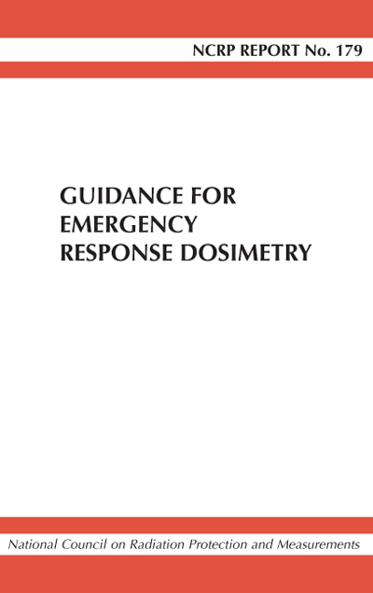
NCRP Report, No. 179, Guidance for Emergency Response Dosimetry
National Council on Radiation Protection and Measurements (NCRP) Report No. 179, Guidance for Emergency Response Dosimetry, complements three previous NCRP publications that provide advice on planning responses to radiological or nuclear terrorism incidents.
The Report provides guidance on the accrual and control of radiation dose in the emergency phase of a radiological or nuclear incident and answers three questions: – With minimal dosimetry resources, how do responders make decisions to control the total dose and associated risk? – How are doses assigned to responders when not every responder is issued a dosimeter before exposure occurs? – What is the regulatory framework for responders who are not trained as radiation workers?
Report No. 179 – Guidance for Emergency Response Dosimetry (2017) - NCRP | Bethesda, MD (ncrponline.org)
Notes:
Description of Image: Cover of Implementation Guidance for Emergency Response Dosimetry. NCRP Commentary No. 28
https://ncrponline.org/shop/commentaries/commentary-no-28-implementation-guidance-for-emergency-response-dosimetry/

Slide 43
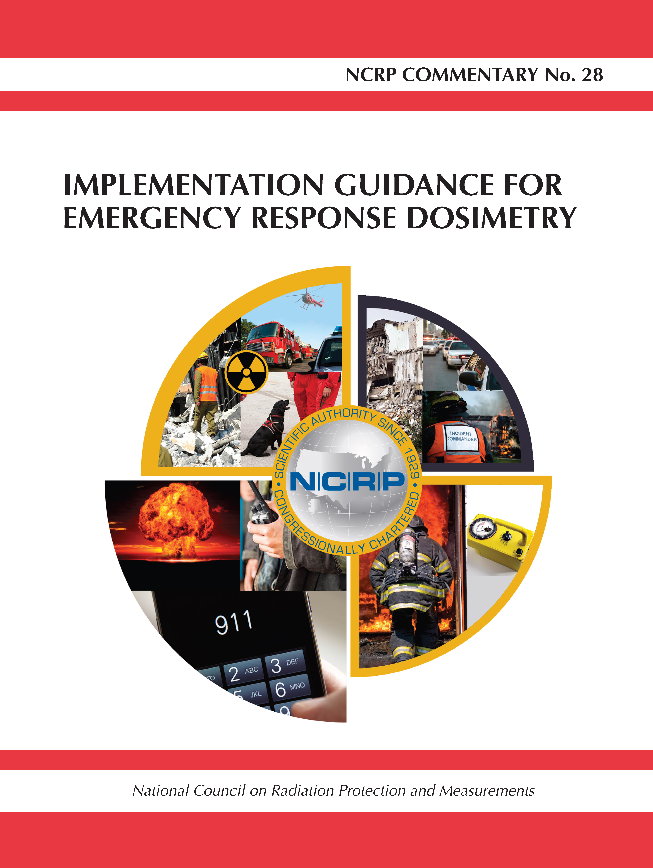
NCRP Commentary, No. 28, Implementation Guidance for Emergency Response Dosimetry
This Commentary is a companion to National Council on Radiation Protection and Measurements’ (NCRP) Report No. 179 (2017), which defined the emergency worker and provided guidance to bridge the gap in managing dosimetry between trained, fully equipped emergency workers and the remainder community of responders during the early response period.
Responders may arrive at the scene without appropriate dosimetry or radiation detection instrumentation and be expected to promptly measure and control radiation exposures while performing their functions, and later be assigned a radiation dose.
Photo credit: NCRP
https://ncrponline.org/shop/commentaries/commentary-no-28-implementation-guidance-for-emergency-response-dosimetry/
Notes:
Description of Image: Cover of Implementation Guidance for Emergency Response Dosimetry. NCRP Commentary No. 28
https://ncrponline.org/shop/commentaries/commentary-no-28-implementation-guidance-for-emergency-response-dosimetry/

Slide 44
Questions Regarding Dose Reconstruction?

Slide 45
Specialized Medical Care
Phase: Intermediate
Objective: Life Safety
Functional Area: Medical Response Coordination
Notes:
This section explores SPECIALIZED MEDICAL CARE as an INTERMEDIATE phase response activity. It falls under the LIFE SAFETY response objective. The public health functional area is MEDICAL RESPONSE COORDINATION.
This section will include a review of
Types of injuries anticipated from an IND (blast, thermal burn, radiation)
Crisis standards of care
RITN as a resource for providing specialized medical care for radiation injuries

Slide 46
Response Objectives, Functions, and Activities SMC
Notes:
Description of image: Response objectives and activities are organized roughly by time phase (early, intermediate, and late) and by objective (life safety, risk mitigation, and recovery). Specialized medical care falls among the intermediate phase life safety activities.

Slide 47
Specialized Medical Care Relationships
Prerequisites
Field medical operations established to provide initial treatment, triage, and transport
Mobilization of screening, decontamination, and dose assessment assets
Medical centers in surrounding areas have implemented surge capacity plans to accept patients from the impacted area
Medical materiel has been accessed through and distributed from the Strategic National Stockpile (SNS)

Slide 48
Specialized Medical Care Learning Objectives
Identify circumstances where patients may need specialized care.
Determine what resources are needed to ensure access to supportive care for those patients who have received fatal doses or suffered radiation combined injury (RCI).
Notes:
The learning objectives for this section are to:
Identify circumstances where patients may need specialized care.
Determine what resources are needed to ensure access to supportive care for those patients who have received fatal doses or suffered radiation combined injury.
The term “radiation combined injury” (RCI) is used to describe conditions where radiation injury is coupled with other insults such as burns, wounds, infection, or blunt trauma

Slide 49
Specialized Medical Care Relationships, cont'd
Concurrencies
Evacuation
Population Monitoring
Dose Assessment
Dependencies
Long-term Health Surveillance

Slide 50
Background: Specialized Medical Care
After initial radiation screening and stabilization, patients with severe thermal or radiation burns or who are at risk for severe acute radiation syndrome (ARS) will transition to expert centers.
Burn casualties require specialized expert care and may be transferred to specialized burn centers.
The total number of burn beds nationwide is extremely limited.
Telemedicine may be necessary to leverage burn expertise for the large surge in patients.
For radiation injury expertise, clinicians should consult the Radiation Injury Treatment Network (RITN).
Some RITN centers may be equipped to handle burn and major trauma injuries.

Slide 51
Background: Specialized Medical Care, cont'd
Trauma centers will also care for victims.
ARS can develop days to weeks after initial exposure; some patients may be managed as outpatients until they develop severe illness.
Telemedicine may be necessary to leverage ARS expertise as well as other specialized assets for the large surge in patients.

Slide 52
Health and Human Services (HHS) Assets
The Secretary of HHS leads the Emergency Support Function (ESF) #8 response.
The Administration for Strategic Preparedness and Response (ASPR) coordinates federal public health and medical assistance under ESF #8.
The primary role of federal resources in providing medical surge capacity and capability (MSCC) is to support, not supplant, State, Tribal, and jurisdictional response efforts.
Notes:
phe.gov/Preparedness/planning/mscc/handbook/chapter7/Pages/default.aspx
Emergency Support Function #8 – Public Health and Medical Services Annex (fema.gov)

Slide 53
Specialized Medical Care Partners
In addition to public health, these partners have a role:
Medical centers, particularly RITN centers
Emergency Medical Services (EMS)
Department of Health and Humans Services (DHHS)
Disaster Medical Assistance Teams (DMAT)
Field Medical Stations (FMS)
Department of Defense (DOD)
DOD Medical Centers
Department of Veterans Affairs
VA Hospitals
Notes:
PROMPT AUDIENCE: Share information for the first bullet, if they haven’t already done so.
The medical response to a large-scale radiation emergency will involve many of the same ESF 8 agencies that respond to other types of disasters. One medical asset that will be essential to providing specialized medical care is the Radiation Injury Treatment Network (RITN).
The Radiation Injury Treatment Network® (RITN) is a national network of medical centers with expertise in the management of bone marrow failure and works with partners from other medical specialties to assist with managing acute radiation syndrome (ARS) and its health-related consequences.

Slide 54
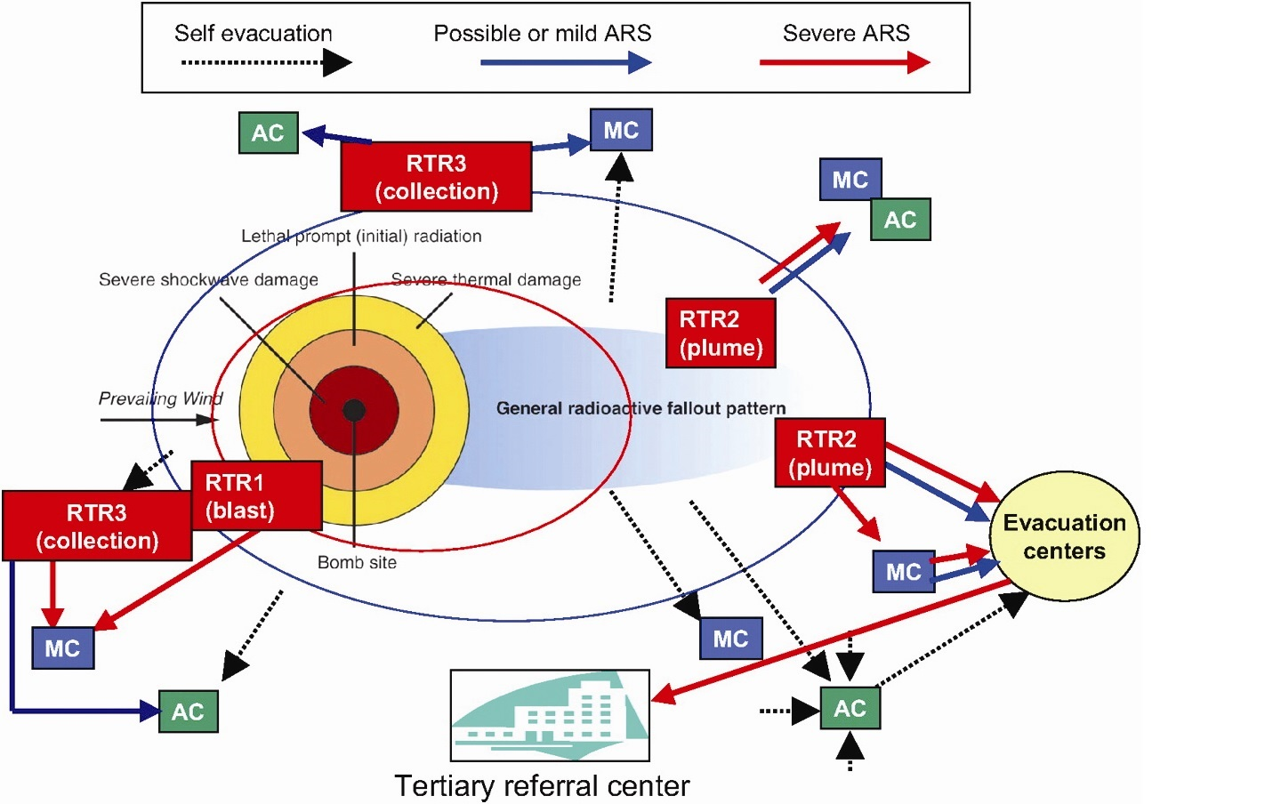
Specialized Medical Care Schematic
Where does specialized medical care occur?
Light damage zone or unaffected area
Low background radiation areas [below 0.1 mR/hr (1 uSv/hr)]
https://remm.hhs.gov/decisionmakersguide.htm
Notes:
Description of Image: Schematic for Triage and Response to a Large-Scale Radiation Event
Specialized medical care will take place at medical facilities outside of the hot zone. Some facilities may be in areas that have light damage and/or elevated background radiation, but will otherwise be fully operational.
This graphic illustrates the general locations of RTR sites relative to medical care facilities, assembly centers (community reception centers) and evacuation centers.

Slide 55
Which patients need specialized care?
People showing signs and symptoms of acute radiation syndrome will be top priority.
Use early, intermediate, and late phase dose assessment to identify priority populations for treatment.
Based on ongoing health surveillance, modify dose range for cytokine treatment to provide maximum benefit.
As additional resources become available, triage categories may be expanded and/or people may be triaged again.
Notes:
REMM provides algorithms for radiation treatment. These reflect radiation issues, not trauma-specific issues.
Triage Guidelines Including Radiation Triage Guidelines - Radiation Emergency Medical Management (hhs.gov)
Contamination
Exposure
Scarce Resources Triage Tool
Exposure + Contamination
Hospital Approach to Patients Presenting After a Nuclear Detonation
Prevailing medical standards of care and triage systems will depend on resource availability, which will change over time.
Nomenclature for standards of care varies across jurisdictions, but are usually divided into three groups:
Conventional
Contingency
Crisis
Nomenclature for resource adequacy also varies but are usually divided into:
Normal
Good
Fair
Poor
When prioritizing delivery of very scarce resources in radiation mass casualty emergencies, it may be appropriate to consider prognosis related to:
Extent of trauma
Extent of external whole body radiation exposure and significant exposure from any internal contamination (e.g., Polonium-210)
Extent of thermal burns - percent body surface area and depth (i.e., degree) of burns
Pre-existing medical conditions that materially affect prognosis of ARS
White blood cell and platelet cytokines are MCMs that can significantly lessen morbidity and mortality in H-ARS patients by increasing the levels of diminished blood elements.
Generally, existing US medical response plans recommend cytokine treatment for victims of nuclear detonation who received 2 gray or more whole body dose from exposure to radiation, unless those patients are triaged to the Expectant category.
Cytokines are stocked in the Strategic National Stockpile (SNS), but additional doses may be available in user managed inventories around the country.
As cytokines will likely be in short supply, at least initially, equitable and effective systems must be used to prioritize patients for cytokine administration until adequate resources arrive.

Slide 56
Specialized Medical Care Key Decisions
Prevailing medical standards of care and triage systems will depend on resource availability, which will change over time.
When prioritizing delivery of scarce resources in radiation mass casualty emergencies, it may be appropriate to consider prognosis related to:
Extent of trauma
Extent of external and internal radiation exposure
Extent of thermal burns
Pre-existing medical conditions that materially affect prognosis of ARS
Medical countermeasures (MCMs) may be in short supply initially – will need to assign appropriate priorities.
E.g., cytokines for patients receiving > 2 Gy
Notes:
REMM provides algorithms for radiation treatment – radiation issues, not trauma-specific. See references
White blood cell and platelet cytokines are MCMs that can significantly lessen morbidity and mortality in H-ARS patients by increasing the levels of diminished blood elements.
Generally, existing US medical response plans recommend cytokine treatment for victims of nuclear detonation who received 2 gray or more whole body dose from exposure to radiation, unless those patients are triaged to the Expectant category.
Cytokines are stocked in the Strategic National Stockpile (SNS), but additional doses may be available in user managed inventories around the country.
As cytokines will likely be in short supply, at least initially, equitable and effective systems must be used to prioritize patients for cytokine administration until adequate resources arrive.

Slide 57
Medical Countermeasures - ARS
Treatment
Perform sequential complete blood counts (CBCs) with differential to assess progressive declines in lymphocyte levels.
Monitor for fluid and electrolyte balance and evidence of hemodynamic instability.
Treat symptomatically with focus on prevention of infection, including antibiotics.
Consider Cytokines such as Neupogen, Neulasta or Leukine.
Perform surgical interventions within the first 48 hours or delay until after hematopoietic recovery.
Notes:
From RADIOLOGICAL EMERGENCIES: Emergency Management Pocket Guide For Clinicians, a two-page pocket guide, found at
https://www.cdc.gov/nceh/radiation/emergencies/pdf/clinicianpocketguide.pdf.
CDC Radiation Emergencies | Treatments for Radiation Exposure and Contamination
CDC Radiation Emergencies | Treatments for Radiation Exposure and Contamination
Information on countermeasures (treatments) that can be used for internal radiation contamination. Provided by the Centers for Disease Control and Prevention (CDC).

Slide 58
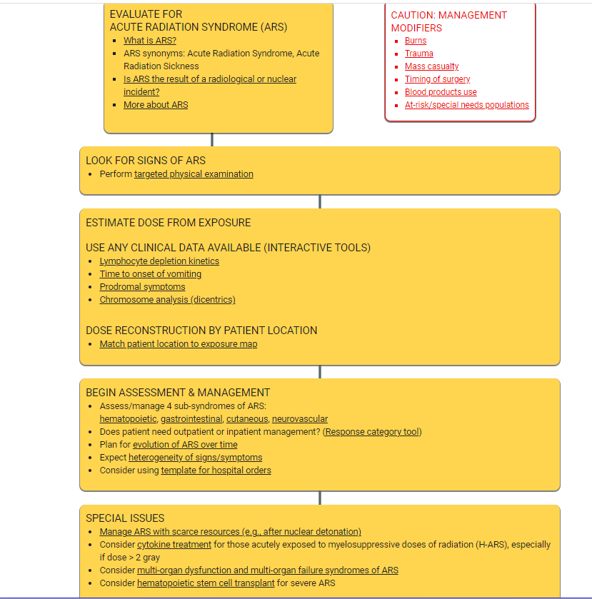
Medical Countermeasures - Exposure
Radiation Emergency Medical Management (REMM) provides algorithms for
management of both exposure
and contamination
Also provides tools for estimating
doses based on
Time to vomiting
Lymphocyte depletion
Dicentric chromosome assay
Radiation Exposure: Diagnose and Manage Acute Radiation Syndrome (ARS) - Radiation Emergency Medical Management (hhs.gov)
58
Notes:
Description of Image: Radiation Exposure: Diagnose and Manage Acute Radiation Syndrome (ARS) Algorithm
Radiation Exposure: Diagnose and Manage Acute Radiation Syndrome (ARS) - Radiation Emergency Medical Management (hhs.gov)

Slide 59
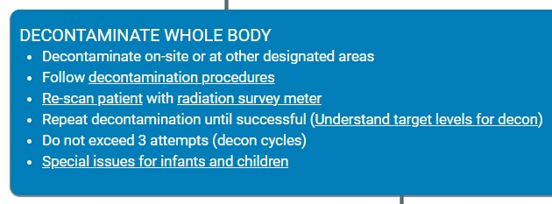
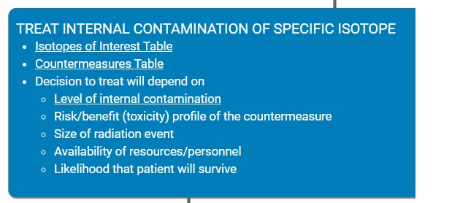
Medical Countermeasures - Contamination
REMM provides algorithms for management of both external and internal contamination.
Countermeasures for internal contamination depend on the specific isotopes involved.
https://remm.hhs.gov/exposureonly.htm
59
Notes:
Description of image: Radiation Contamination: Diagnose and Manage Algorithm
Radiation Exposure: Diagnose and Manage Acute Radiation Syndrome (ARS) - Radiation Emergency Medical Management (hhs.gov)

Slide 60
What resources are needed to ensure enough access to supportive care for those who have received fatal doses?
Use early and intermediate dose assessment to develop radiation fatality projections.
Assess palliative care resources and identify shortfalls.
Notes:
People with a high dose whose outcome is grim must be identified for appropriate management.
Since there is no chance for survival after irradiation with a dose of more than 10 to 12 Gy, it is appropriate for definitive care to be withheld from such individuals.
Rather than being treated aggressively, these patients should be provided with comfort measures. This includes attention to pain management and general comfort as well as administration of antiemetic and antidiarrheal agents.
In this devastating situation, psychological support and pastoral care are essential not only for the patient but also for family and friends, who may experience traumatic grief.

Slide 61
How do you communicate to the public about decisions involving allocation of scarce resources?
Successful communication depends on credibility and trust.
Two influencers of credibility are the speed of release and the accuracy of information.
Establish trust through empathy and openness.
Maintain transparency in the decision process at the state and local levels.
Adhere to and communicate applicable Standard of Care guidelines.
Reassure that palliative care will be provided for the most severely ill.
Notes:
Allocation of Scarce Resources During Mass Casualty Events - NCBI Bookshelf (nih.gov)
This systematic review sought to identify the best available evidence regarding strategies for allocating scarce resources during mass casualty events (MCEs).
Only 10 studies included strategies that consider the public's perspective.
However, these studies were consistent in their findings. In particular, the public believes that resource allocation guidelines should be simple and consistent across health care facilities but should allow facilities some flexibility to make allocation decisions based on the specific demand and supply situation.
The public also believes that a successful allocation system should balance the goals of ensuring the functioning of society, saving the greatest number of people, protecting the most vulnerable people, reducing deaths and hospitalizations, and treating people fairly and equitably.
Resource Allocation on the Frontlines of Public Health Preparedness and Response: Report of a Summit on Legal and Ethical Issues (nih.gov)
This report presents the findings of a Summit of academic and practice experts to develop a set of principles for legally and ethically sound public health resource triage decision-making in emergencies.

Slide 62
How do you communicate to the public about decisions involving allocation of scare resources? Cont'd
Explain:
What resources are available
Why some resources are not available
Limited supplies are being used for people with the greatest need
Who the people are with the greatest need and those that could benefit the most from the MCM.
Reasonable actions that people can take, so that they do not focus on things they cannot have
Notes:
Communication Strategies to Persuade the Public to Avoid Seeking Special Treatment from: CDC (2014). CERC: Other Communication Channels
Crisis and Emergency Risk Communication (Manual): Updated 2014 -- Other Communication Channels (cdc.gov)
Who the people are with the greatest need and those that could benefit the most from the MCM-For example people that received very high doses (>10 Gy have a great need but providing MCMs will not change their survival, whereas someone with 4-6 Gy will have a greater chance of survival and recovery if MCMs are provided.

Slide 63
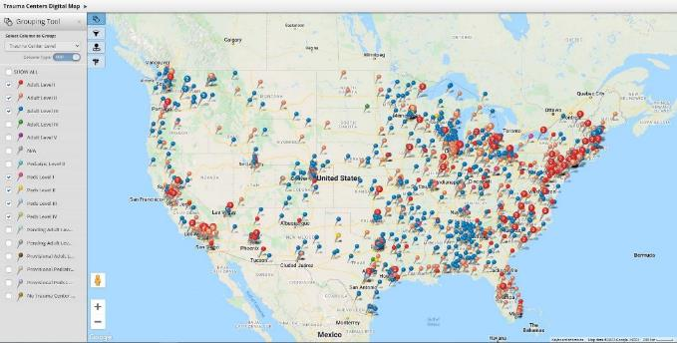
US Trauma and Disaster Response Centers
Trauma Center Association of America (TCAA), Inc. https://www.traumacenters.org/page/USTraumaDisasterCenters
Notes:
Description of image: Map of the United States depicting locations of US Trauma and Disaster Response Centers.
REMINDER: The casualty estimates from Slide 16 for blast, radiation, and thermal effects is 80,400.

Slide 64
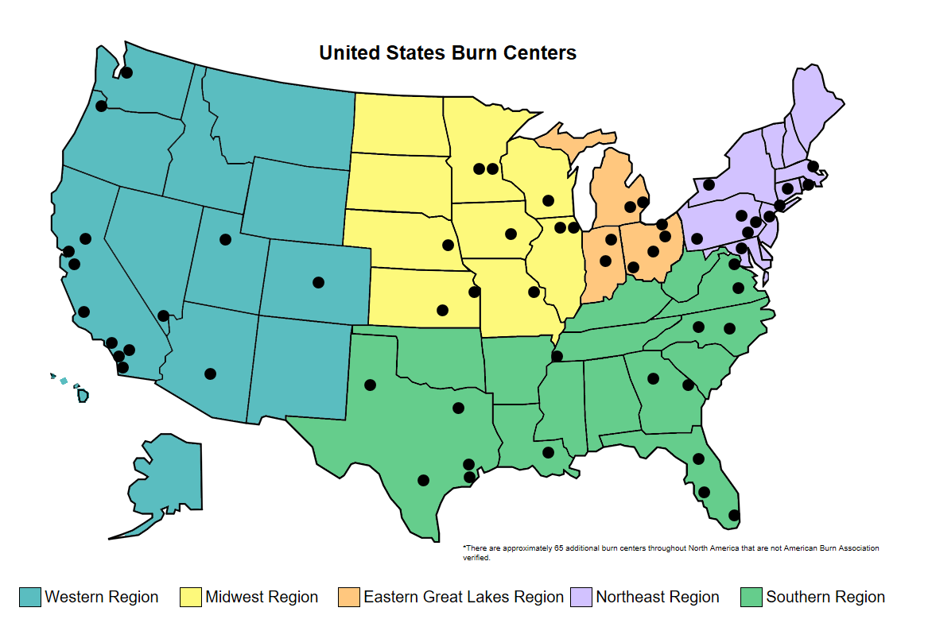
United States Burn Centers
*In addition to burn centers, some states may have burn surge plans that will utilize non-burn centers to treat lower acuity burns.
https://understandingburncare.org/locations/
​
Notes:
Description of Image: Map of United States Burn Centers
If the two burn centers in ATL are taken offline, how do we manage 53,700 patients with second and third degree burns? Do we triage by degree of burn injury? By estimated radiation dose? By combined injury? How much burn care can be administered in the field?
URL: Burn Center Locations – Understanding Burn Care

Slide 65
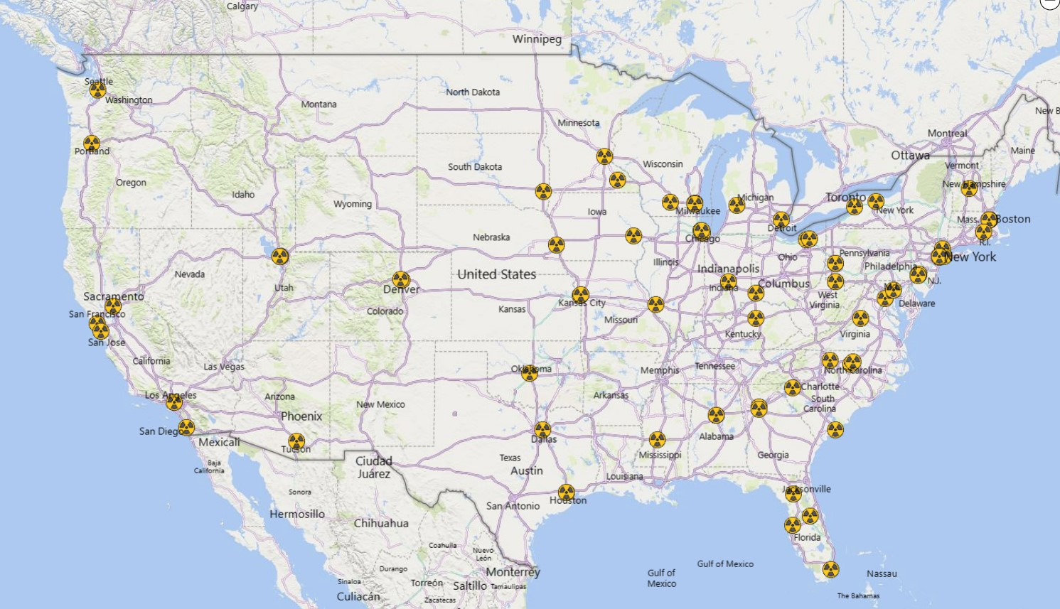
Radiation Injury Treatment Network [RITN]
*In addition to RITN hospitals, hospitals with BM [Burn Management] treatment can also be utilized. https://ritn.net/about/about-ritn
Notes:
Description of image: map of the United States depicting the location of the RITN hospitals/medical centers.
The RITN network consists of medical centers that specialize in the management of bone marrow failure and acute radiation syndrome (ARS). RITN’s mission is to maximize-health related outcomes among casualties with ARS.
–Before the disaster, RITN develops treatment guidelines for managing hematologic toxicity among casualties of radiation exposure and educates health care professionals about pertinent aspects of radiation exposure management through training and disaster exercises. –During the disaster, RITN centers provide comprehensive evaluation and treatment in both inpatient and outpatient settings. The RITN control cell helps to coordinate the response and shares critical information about the disaster between RITN hospitals and governmental agencies, including the Department of Health and Human Services (DHHS), Assistant Secretary of Preparedness and Response (ASPR). –After the disaster, RITN centers collect and share patient data for research through the Center for International Blood and Marrow Transplantation Research.
Total number of RITN centers 74+
RITN

Slide 66
Specialized Medical Care Resources

Slide 67
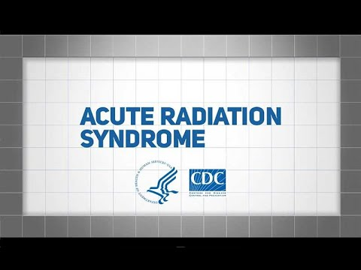
Acute Radiation Syndrome Video
This video provides an overview of Acute Radiation Syndrome, also known as ARS.
https://www.cdc.gov/nceh/radiation/emergencies/protectiveactions.htm
Notes:
Description of Image: This video provides an overview of Acute Radiation Syndrome, also known as ARS.
https://www.cdc.gov/nceh/radiation/emergencies/protectiveactions.htm

Slide 68
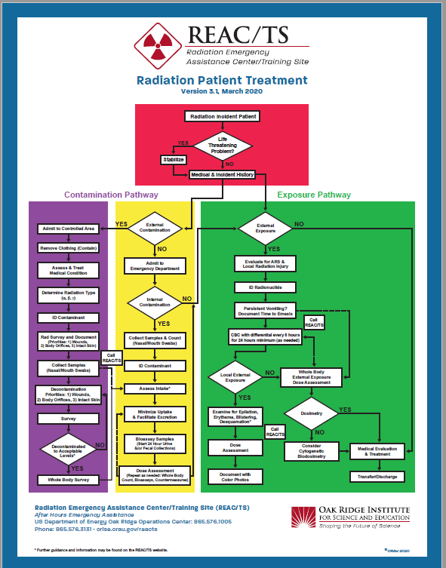
Radiation Patient Treatment Algorithm
The Radiation Emergency Assistance Center/Training Site (REAC/TS) provides a concise algorithm to aid in determining who needs specialized care.
https://orise.orau.gov/resources/reacts/documents/radiation-patient-treatment-algorithm.pdf
Notes:
Description of Image: Radiation Patient Treatment Algorithm
https://orise.orau.gov/resources/reacts/documents/radiation-patient-treatment-algorithm.pdf

Slide 69
CDC Radiation Emergencies: Information for Clinicians
This web page contains links to extensive information on medical care and medical countermeasures for victims of radiation accidents, intended for clinicians of all specialties.
Photo credit: CDC
https://www.cdc.gov/nceh/radiation/emergencies/clinicians.htm
Notes:
Description of Image: Healthcare professional writing notes, shown on CDC clinician web page
This and many other resources for clinicians can be found at https://www.cdc.gov/nceh/radiation/emergencies/clinicians.htm
That includes one particular resource on medical countermeasures:
https://www.cdc.gov/nceh/radiation/emergencies/countermeasures.htm

Slide 70
Specialized Medical Care References

Slide 71
The Medical Aspects of Radiation Incidents, 4th Ed.
This document provides basic information to physicians and other healthcare professionals necessary for the proper medical management of radiation injuries.
https://orise.orau.gov/resources/reacts/documents/medical-aspects-of-radiation-incidents.pdf
Notes:
Description of Image: Cover of The Medical Aspects of Radiation Incidents, 4th Edition document.
https://orise.orau.gov/resources/reacts/documents/medical-aspects-of-radiation-incidents.pdf

Slide 72

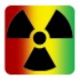
Triage Guidelines Including Radiation Triage Guidelines
REMM provides algorithms for radiation treatment. Algorithms cover exposure, contamination, and exposure plus contamination situations.
Interactive Triage Tool helps clinicians determine appropriate triage categories for patients with radiation, physical, or combined injuries.
https://remm.hhs.gov/radtriage.htm
Notes:
Description of Images: Radiation Emergency Medical Management (REMM) Logo, radiation symbol
https://remm.hhs.gov/radtriage.htm

Slide 73
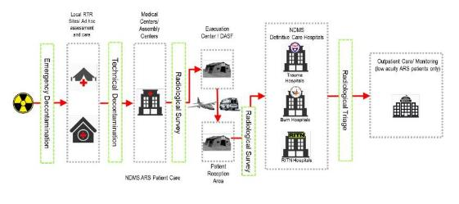
RITN Acute Radiation Syndrome Treatment Guidelines
Provides guidance on:
Principles of ARS management
Crisis standards of care
Casualty triage
Stem cell support
https://remm.hhs.gov/RITN-ARS-Treatment-Guidelines-21Oct-FINAL.pdf
Notes:
Description of Image: Conceptual Flow of Casualties to a RITN Center
RITN ARS Treatment Guidelines
The RITN ARS Treatment Guidelines cover:
Principles of ARS management
Crisis standards of care
Triage
Stem cell supportive care
https://remm.hhs.gov/RITN-ARS-Treatment-Guidelines-21Oct-FINAL.pdf

Slide 74
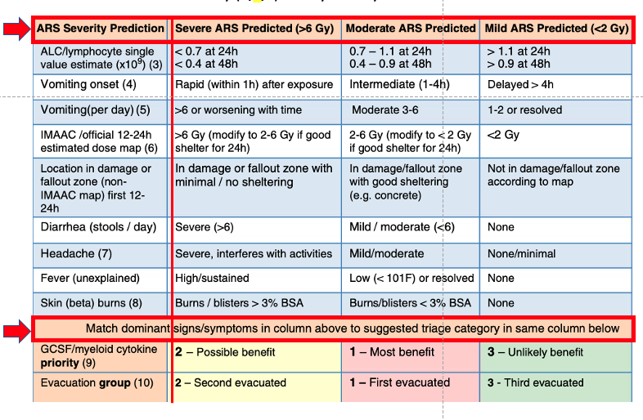
Exposure and Symptom Triage (EAST) Tool to Assess Radiation Exposure After a Nuclear Detonation
This proposed tool has not been validated in a real-world radiation incident.
It is not "binary" with respect to triage decision; it is more of a risk matrix than a decision tool.
It has limited predictive value compared to serial absolute lymphocyte counts and definitive biodosimetry tests, but it
Is better than "ad hoc" decisions
Provides planning and implementation structure
Provides a level of fairness and consistency
https://remm.hhs.gov/EAST-tool-notes.htm
Notes:
Description of Image: Exposure and Symptom Triage (EAST) Tool to Assess Radiation Exposure After a Nuclear Detonation
https://remm.hhs.gov/EAST-tool-notes.htm

Slide 75
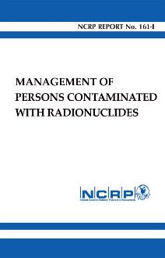
NCRP, No. 161: Mangement of Persons Contaminated With Radionuclides
The focus of this report is on the medical management of individuals exposed to and potentially contaminated with radionuclides.
https://ncrponline.org/shop/reports/report-no-161-i-management-of-persons-contaminated-with-radionuclides-handbook/
Notes:
Description of Image: Cover of NCRP No. 161: Management of Persons Contaminated With Radionuclides
The first volume of this report is a handbook of guidance on dealing with contamination in the field, in transit to a hospital, and at a medical facility, followed by a section on post-treatment follow-up and handling of contaminated decedents. The second volume contains the scientific and technical bases for the recommendations in the first volume.
https://ncrponline.org/shop/reports/report-no-161-i-management-of-persons-contaminated-with-radionuclides-handbook/

Slide 76

Mass Burn Event Overview
This document provides guidance for healthcare coalitions, burn centers, state public health preparedness professionals, healthcare entities, and other stakeholders planning for a burn mass casualty incident (BMCI).
This document identifies the key roles of state and local responders, and those of the American Burn Association (ABA) and the U.S. Department of Health and Human Services (HHS) Administration for Strategic for Preparedness and Response (ASPR) during a BMCI.
https://files.asprtracie.hhs.gov/documents/aspr-aba-oem-mass-burn-event-overview.pdf
Notes:
Description of Image: ASPR TRACIE | Healthcare Emergency Preparedness Information Gateway Logo
https://files.asprtracie.hhs.gov/documents/aspr-aba-oem-mass-burn-event-overview.pdf

Slide 77
Questions regarding SMC?

Slide 78
Re-entry
Phase: Intermediate / Late
Objective: Recovery
Functional Area: Risk Communication / Radiation Health Assessment
Notes:
This section explores RE-ENTRY as an INTERMEDIATE phase response activity. It falls under the RECOVERY response objective. The public health functional areas are RISK COMMUNICATION / RADIATION HEALTH ASSESSMENT.

Slide 79
Response Objectives, Functions, and Activities Re-entry
Notes:
Description of image: Response objectives and activities are organized roughly by time phase (early, intermediate, and late) and by objective (life safety, risk mitigation, and recovery). Re-entry falls among the intermediate phase recovery activities.

Slide 80
Re-entry Learning Objectives
Define re-entry (as distinguished from relocation or return).
Describe circumstances in which re-entry may be appropriate.
Identify communications strategies that can be used to facilitate re-entry.
Notes:
The learning objectives for this section are to:
Distinguish the difference between re-entry, relocation, and return.
Describe circumstances in which re-entry may be appropriate.
Identify communications strategies that can be used to facilitate re-entry.

Slide 81
Re-entry Relationships
Prerequisites
Field measurements and dose estimation to determine stay times
Identification and prioritization of critical functions/infrastructure
Concurrencies
Dose assessment
Food/water safety
Fatality management
Dose reconstruction
Monitoring and treatment for late medical effects

Slide 82
Re-entry Relationships, cont'd.
Dependencies
Recovery
No longer responding to an "emergency situation"
Response activities will require people to re-enter to:
Begin environmental remediation efforts (e.g., cleanup, site recovery)
Maintain/restore critical infrastructure
Reestablish routine services

Slide 83
Background: Re-Entry
The term re-entry is used for emergency workers and members of the public going into radiologically contaminated areas, temporarily, under controlled conditions.
People will need to re-enter for a variety of reasons, including recovery activities, retrieval of property, security patrol, operation of vital services and, in some cases, care and feeding of farm and other animals.

Slide 84
Recommended Dose Limits to Temporarily Re-enter an area
Members of the public
Up to 2 rem (20 mSv) in the first year
Up to 0.5 rem (5 mSv) annual limit in subsequent year
Responders/Workers
Up to 5 rem (50 mSv) per year

Slide 85
Re-entry Partners
In addition to public health, these partners may have a role:
State and local elected officials
Federal Radiological Monitoring and Assessment Center (FRMAC)/Advisory Team
Environmental Protection Agency (EPA)
Federal Emergency Management Agency (FEMA)
United States Department of Agriculture (USDA)
Radiation control
Law enforcement
Industry and community stakeholders
Notes:
PROMPT AUDIENCE: Share information for the first bullet, if they haven’t already done so.

Slide 86
What makes an area eligible for re-entry?
Re-entry involves temporary access to a contaminated area for short durations to conduct specific tasks or gather belongings.
Re-entry may occur at:
Critical infrastructure (e.g., chemical factories, utility stations, water treatment plants, farms with animals, etc.)
Private residences

Slide 87
What are acceptable environmental radiation levels for re-entry?
The recommended dose limits to temporarily re-enter an area are:
Members of the public
Up to 2 rem (20 mSv) in the first year
Up to 0.5 rem (5 mSv) annual limit in subsequent years
Stay time considerations based on amount and type of exposure rate and loose/airborne contamination
Responders/Workers
Up to 5 rem (50 mSv) per year
Notes:
Table 4-2 in the EPA PAGs provides a good summary of dose and activity limits for re-entry. Limits are based on dose rate as well as airborne concentration of specific radionuclides. The stay times will take these factors into account.
Because cleanup is not an emergency function, responder exposures will be limited to 5 rem/yr.

Slide 88
Protective Action Dose Criteria
PHASE ​ | ACTIVITY ​ | SUGGESTED LEVELS ​
Early Phase ​ | Sheltering or Evacuation for the Public ​ | 1-5 rem (10-50 mSv) projected over four days ​ ​ A decision to evacuate weighs anticipated dose against feasibility of evacuating within a determined time frame, along with the risks associated with the evacuation itself. ​
Intermediate ​ | Re-entry Relocation ​ Return | 2 rem (20 mSv) projected first year ​ ​ 0.5 rem (5 mSv) per year projected in subsequent years.​ ​ Local decision-makers can adapt the guidelines and implement variations as needed. ​
Emergency Worker Protection | 5/10/25 rem (50/100/250 mSv) incurred over the response duration. The higher limits are based on task (e.g., protecting large populations or critical infrastructure or lifesaving). Emergency worker doses will be tracked with dosimeters. Emergency workers have knowledge of the risks associated with radiation exposure, training to protect themselves, and dosimeters to track their doses.
Adapted from EPA PAG Manual, Tables 4-1 and 4-2.
Notes:
Description of images: A summary of recommended dose levels warranting various protective actions. The dose levels for re-entry, relocation, and return are the same. A summary of recommended dose limits for emergency workers.
Table 4-2 in the EPA PAGs provides a good summary of dose and activity limits for re-entry

Slide 89
What communications strategies can be used to help determine if people can re-enter an area?
People will want to know which areas they can access and how long they can stay there.
Broad communications strategies, like producing zoned maps and corresponding stay time charts, may be useful.
Individual risk communication will take place between radiation safety personnel and the individuals at the access point.
This communication may include information about:
Exposure vs. contamination
Dose rate and stay times
Proper wear and use of dosimeters
Proper wear and use of PPE
Notes:
For re-entry, people will want to know which areas they can access and how long they can stay there.
Each person will have slightly different needs when it comes to re-entry
Broad communications strategies, like producing zoned maps and corresponding stay time charts, may be useful.
Individual risk communication will take place between radiation safety personnel and the individuals at the access point.
Risk communications may include information about:
Exposure vs. contamination
Dose rate and stay times
Proper wear and use of dosimeters
Proper wear and use of PPE

Slide 90
Re-entry Resources

Slide 91
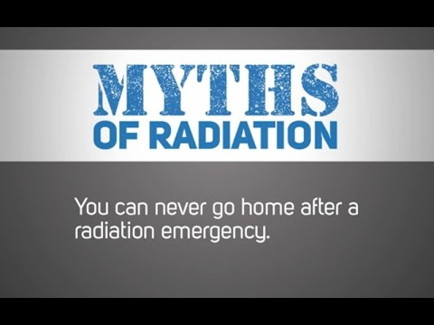
Communicating in Radiation Emergencies: Myths of Radiation?
This video introduces participants to some common myths of radiation and identifies communications strategies to combat these myths.
Provides communication strategies for talking about:
Factors for returning home
Community-based decision making
https://www.cdc.gov/nceh/radiation/emergencies/radiationmyths.htm
Notes:
Description of Image: Communicating in Radiation Emergencies: “Myths” of Radiation – Myth 7
https://www.cdc.gov/nceh/radiation/emergencies/radiationmyths.htm

Slide 92
Re-entry References

Slide 93

PAG Manual: Protective Action Guides and Planning Guidance for Radiological Incidents, Chapter 4
See chapter 4, especially section 4.5 and Table 4-2, Re-entry Matrix.
https://www.epa.gov/sites/default/files/2017-01/documents/epa_pag_manual_final_revisions_01-11-2017_cover_disclaimer_8.pdf
Notes:
Description of Image: Cover of PAG Manual: Protective Action Guides and Planning Guidance for Radiological Incidents
https://www.epa.gov/sites/default/files/2017-01/documents/epa_pag_manual_final_revisions_01-11-2017_cover_disclaimer_8.pdf
Look in Chapter 4, especially section 4.5 and Table 4-2, re-entry Matrix.

Slide 94
Questions regarding Re-entry?

Slide 95
Disclaimer
The findings and conclusions in this presentation are those of the authors and do not necessarily represent the official position of the Centers for Disease Control and Prevention/the Agency for Toxic Substances and Disease Registry.

Slide 96
508 Compliance Disclaimer
CDC cannot verify the compliance of documents produced by outside agencies and companies.
If you have problems accessing them, please contact the vendor directly or file an accessibility report and mention the name of the file, so we can assist you.
https://www.cdc.gov/other/disclaimer.html

